Slide 1
Chapter 13
Capital budgeting techniques
Slides by Prof C Rootman,
Dr S Watson, Ms E Kobese
& Ms N Maliwa

Slide 2
Learning outcomes: Chapter 13
apply an appropriate approach to the capital budget decisions
calculate the average rate of return and payback period of capital expenditure proposals
calculate and interpret the net present value (NPV), profitability index (PI), and internal rate of return (IRR)
evaluate projects with conflicting NPV rankings.

Slide 3
Example of capital budgeting
CEREBOS: Salt producer expands, diversifies

Slide 4
Example of capital budgeting
Source: Adapted from
https://easterncapeindustrialnews.co.za/salt-producer-expands-diversifies/

Slide 5
Examples of capital budgeting (cont.)
Chinese giant teams up with PPC in South Africa
Source: Adapted from Fraser, L. https://businesstech.co.za/news/business/807100/chinese-giants-team-up-for-new-r3-billion-plant-in-south-africa/; https://www.engineeringnews.co.za/article/ppc-cement-plant-south-africa-update-2025-08-08

Slide 6
Introduction
Ch 6 we valued financial assets and determined required rates of return
Now apply these concepts to investment decisions involving fixed (non-current) assets: capital budgeting
∴ Capital budgeting refers to a firm’s investment in new LT assets (remember Ch 1…)
Process of analysing projects – which are acceptable and which should ultimately be selected
Firms have various capital investment options available – some of these options are valuable and some are not…
Which are valuable…? Which will contribute to the firm’s goal of shareholder wealth maximisation?
Techniques available to analyse potential capital investments / business ventures to decide which are worth undertaking

Slide 7
Introduction (cont.)
Must decide carefully…make informed decisions…
You already have 2 coffee shop outlets in GQ. Think about opening another coffee shop (outlet) somewhere in GQ…you are considering 1 of 3 possible areas…
LT in nature, high costs, loose flexibility, timing NB (should have assets when needed, etc.)
Poor capital budgeting affects product mix and hence sales ⇒ lower NPAT or EAT ⇒ lower DPS ⇒ lower share price ⇒ a decline in SHW

Slide 8
Introduction
Evident from Ch 12 that CFs associated with the implementation of a capital budgeting project (investment) transpire over several years
CFs matter (inflows vs outflows)
Timing of CFs matter
Risk matter
Therefore…TVM principles considered in calculations
An investment can only add value if its return > the required rate of return (RRR) (if IRR > WACC go for project)
Measure its return by using various investment criteria/techniques/methods

Slide 9
Approaches to decision making
Accept-reject approach
Have predetermined criteria
Apply technique(s)
Compare return with minimum acceptable/required return
Make accept or reject decision
Ranking approach
Useful if mutually exclusive (ME) projects
ME? Have many options (ito a particular investment or @ a particular time), evaluate all, BUT…can only select one…the BEST

Slide 10

Capital budgeting techniques
Non-discounted CF methods
We will cover 2
Average rate of return
Payback period
Discounted CF methods
We will cover 4
Discounted payback period
Net present value (NPV)
Profitability index (PI)
Internal rate of return (IRR)
#1 and #2
Based on prev chpts…do you know the difference? THINK ABOUT IT…
#1 to #4

Slide 11
Capital budgeting techniques (cont.)
To evaluate a project, we need its CF₀ (II), annual net cash flows (operating cash flows) and terminal CF as well as the discount rate
Remember how to calculate the CFs? Chapter 12…
A reminder, for the annual net cash flows:
NOPAT + depreciation
OR
EBIT + depreciation – tax
Let’s discuss/explain/work through all 6 investment criteria with an example…
The CFs have been calculated (as per Ch 12)

Slide 12
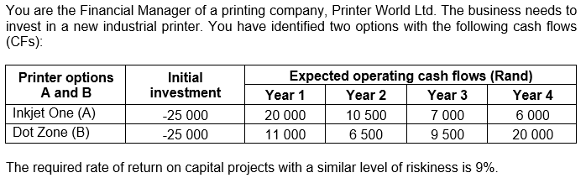
Capital budgeting techniques (cont.)
Note: Firm desires projects to be paid back (costs covered) within a 3-year period
Reminder: RRR and discount rate are the same thing

Slide 13
Capital budgeting techniques (cont.)
#1
Average rate of return
Initial screening
Average rate of return = Average earnings after taxes / Average investment
Our example the average investment of both A and B is: 25 000 / 2 = 12 500
Assume the average earnings after taxes for A = R4 800 and for B = R4 250
Average rate of return A = 4 800/ 12 500
= 38.40%
Average rate of return B = 4 250/ 12 500
= ……..%
Both A and B acceptable since ARR > RRR; Can only choose one? Select A with highest ARR

Slide 14
Capital budgeting techniques (cont.)
#2
Payback period
Payback on a proposed investment is the length of time it takes to recover the initial investment or cost
Stated differently: payback is the amount of time required for an investment to generate sufficient CFs to recover its initial cost
An investment is acceptable if the payback period is less (<) than pre-specified number of periods (months, years etc.)
Discounted payback period
Same as above, just work with discounted CFs (PVs)
#1

Slide 15
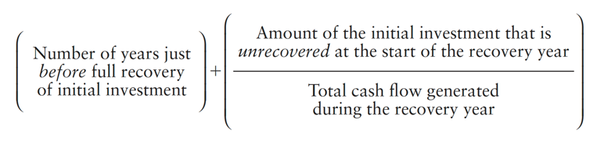
Capital budgeting techniques (cont.)
DPB better; Why?
TVM…CFs that occur in the future are worth less today because there is risk involved – and we factor risk into our TVM calculations by means of a discount rate (use discounted CFs in the DPB technique)
What are the risks associated with capital projects? E.g.?
Competitors might move faster with the implementation of a capital project which messes up the firm’s projections of future inflows (to stay competitive the firm might have to reduce the price of their products; costs might increase due to inflation; etc.)

Slide 16


Capital budgeting techniques (cont.)
#2
Payback period
Project A
= 1 + (5 000 / 10 500) = 1.48 years
Project B
= 2 + (7 500 / 9 500) = 2.79 years
Both A and B acceptable since Payback period for the projects less < than the specified cut-off (“maximum”) period of 3 years
Can only choose one? Select A with shortest Payback

Slide 17
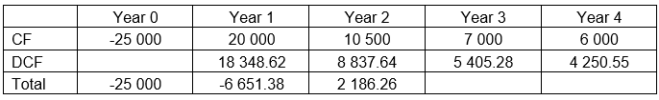
Capital budgeting techniques (cont.)
Discounted payback period
Project A
= 1 + (6 651.38 / 8 837.64) = ………years
Project A is acceptable since Discounted
payback period for the project less < than the
specified cut-off (“maximum”) period of 3 years
#1
Y1: FV -20 000,
n 1, I 9, COMP PV;
Y2: FV -10 500, n 2, I 9, COMP PV;
Etc.

Slide 18
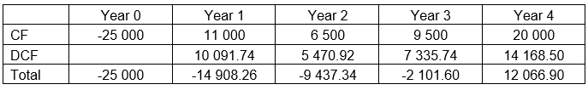
Capital budgeting techniques (cont.)
Discounted payback period
Project B
= 3 + (2 101.60 / 14 168.50) = 3.15 years
Project B should be rejected since
Discounted payback period for the
projects longer > than the specified
cut-off (“maximum”) period of 3 years;
thus Select A
IF both were acceptable and you can only choose one? Select A with shortest Discounted payback (costs to be recovered sooner)
#1
Can you get these DCFs? Surely! You know how to get PVs by now…

Slide 19

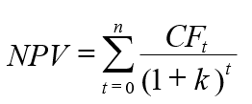
Capital budgeting techniques (cont.)
#2
Net present value (NPV)
Shows how much value (in monetary terms) a project creates for firm’s shareholders
NPV = difference between an investment’s market value (i.e. PV of all future CFs) and its initial cost (or outlay)
Stated differently NPV = PV of all future CFs:
Decision rule: A project is acceptable if its NPV is positive (i.e. if the PV of all future CFs > the initial cost of the project; what you receive as a result of implementing a project should exceed the cost of the project)

Slide 20
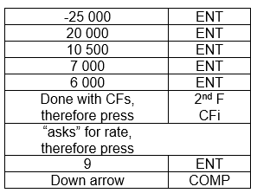
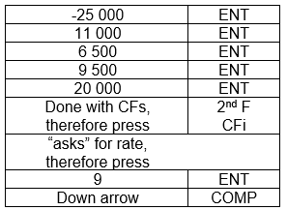
Capital budgeting techniques (cont.)
#2
Net present value (NPV)
Project A Project B
NPV A = R11 842.10 NPV B = R………………
Both A and B acceptable since NPV > 0
Can only choose one? Select B with highest NPV

Slide 21

Capital budgeting techniques (cont.)
#3
Profitability index (PI)
Linked to NPV criterion; measures PV return per Rand invested
PI = total PV of CFs / initial investment
Acceptable if > 1
Our example: assume total PVs given OR can calculate it as NPV + II
Project A Project B
= 36 842.10 / 25 000 = 37 066.91 / 25 000
PI A = 1.47 PI B = 1.48
Both A and B acceptable since PI > 1;
Can only choose one? Select B with highest PI

Slide 22
Capital budgeting techniques (cont.)
#4
Internal rate of return (IRR)
With the IRR we try to find a single rate of return that summarises the merits of a project – what is the return that a specific project generates?
Average return project is expected to generate each year of its life
IRR = required return that results in a zero NPV when it is used as the discount rate
IRR rule: project acceptable if the IRR exceeds the required rate of return (R)

Slide 23
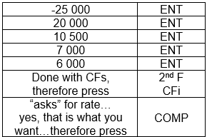
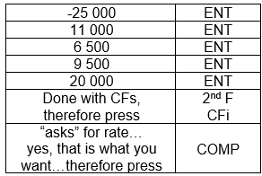
Capital budgeting techniques (cont.)
#4
Internal rate of return (IRR)
Project A Project B
IRR A = 35.74% IRR B = ………%
Both A and B acceptable since IRR > RRR of 9%
Can only choose one? Select A with highest IRR

Slide 24
Comparing techniques
Can you remember our 2 printer projects/options?
These were the results at a discount rate of 9%:
Conflicting rankings…
Using NPV and IRR but you get conflicting results

Slide 25
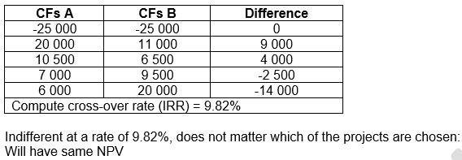
Comparing techniques (cont.)
Same as when doing IRR calculation; just use “difference” CFs now
Calculate cross-over rate
To know what to expect at
different discount rates
You can CHECK it…calculate both NPVs at a discount rate of 9.82%...

Slide 26
Comparing techniques (cont.)
With cross-over rate we will know
At discount rates BELOW 9.82%, there will be conflicting rankings ☹
Warning sign! Be careful with these projects…maybe think twice before selecting…Do you really want to select one of these…?
(Earlier we saw this at a 9% discount rate, when NPV showed B and IRR showed A; in fact, in our example, it was ONLY NPV that showed B…)

Slide 27
Comparing techniques (cont.)
With cross-over rate we will know
At discount rate ABOVE 9.82%: there will be no conflicting rankings ☺
We will know, without a doubt, which project to choose…
CHECK THIS: calculate both NPVs with a 12% discount rate…
(using our example, both criteria will show:
Select A)
Cross-over rate NB to use when we have mutually exclusive projects
Helpful in decision making!

Slide 28

Checking slide for YOU…
Did you calculate NPVs and IRRs of the 2 projects by using a discount rate of 12%?
With discount rate ABOVE cross-over rate of 9.82%:
Yes, both criteria give the same results (in this example both indicates Select A)

Slide 29
Extra notes
NPV takes precedence…it is the best technique
Other investment criteria are flawed in some ways, so the NPV, with no serious flaws, is the preferred decision rule. Specifically, the NPV technique explicitly considers TVM and risk (evident in the NPV equation)
NPV profile: graphical representation of the relationship between an investment’s NPVs and various discount rates
Thus, the NPV profile shows how the NPV of a project vary as the discount rate applied to its future cash flows changes

Slide 30
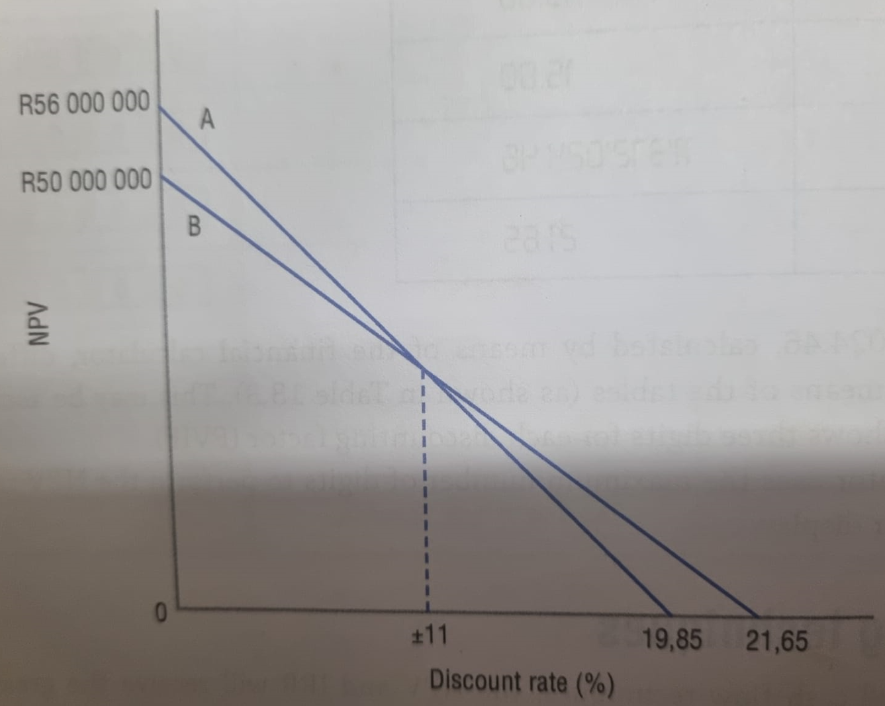
Extra notes (cont.)
NPV profile example: Figure 13.3

Slide 31
Preparation for next session
Work through Chapter 13
Questions in study guide
Problems at the end of the chapter
Read through Chapter 14 and download/print the slides

